Slide 1
Introduction to Data Communication
Vinit Tribhuvan
vrt22.comp@coep.ac.in
1
Notes:
Data Communication

Slide 2
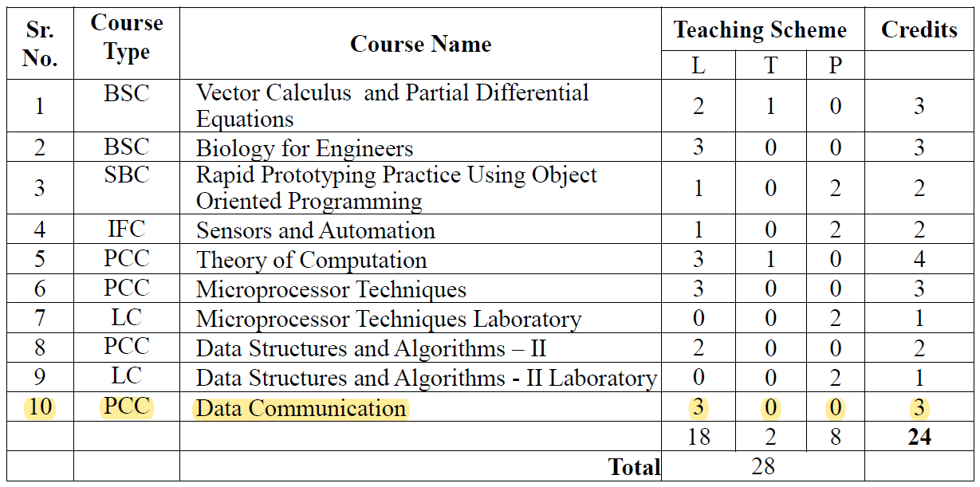
Course Summary

Slide 3
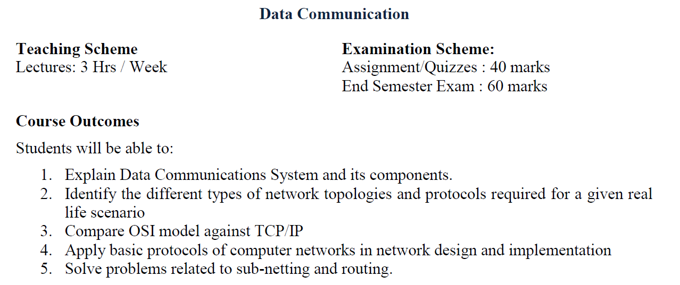
Course structure and CO

Slide 4
Contents
Data Communication,
Networks and Internet,
Protocols and Standards,
Network Models: OSI, TCP/IP
Analog and Digital data,
Periodic Analog Signal,
Digital Signal,
Transmission Impairments,
Data Rate Limits,
Performance.
Signal Conversion: digital-to-digital, Analog-to-Digital, Analog-to-Analog, Digital-to-Analog Conversion
4
Notes:
Data Communication

Slide 5
Introduction
Communication - sharing information.
This sharing can be local or remote.
Local communication usually occurs face to face
Remote communication takes place over distance.
The term telecommunication, which includes telephony, telegraphy, and television, means communication at a distance (tele is Greek for "far").
The word data refers to information presented in whatever form is agreed upon by the parties creating and using the data.
5
Notes:
Data Communication

Slide 6
Data Communication
DC is the exchange of data between two devices via some form of transmission medium (cables, etc.)
The communication system made up of a combination of hardware (physical equipment) and software (programs).
The effectiveness of a DC system depends on the following four fundamental characteristics:
delivery
accuracy
timeliness
jitter
6
Notes:
Data Communication

Slide 7

Effectiveness of DC System
Delivery
The system must deliver data to the correct destination. Data must be received by the intended device or user and only by that device or user.
Accuracy
The system must deliver the data accurately.
Data that have been altered in transmission and left uncorrected are unusable.
7
Notes:
Data Communication

Slide 8

Effectiveness of DC System
Timeliness
The system must deliver data in a timely manner.
Data delivered late is useless.
In the case of video and audio, timely delivery means delivering data as they are produced, in the same order that they are produced, and without significant delay.
This kind of delivery is called real-time transmission.
8
Notes:
Data Communication

Slide 9
Effectiveness of DC System
Jitter
Jitter refers to the variation in the packet arrival time.
It is the uneven delay in the delivery of audio or video packets.
For example,
let us assume that video packets are sent every 30 ms.
If some of the packets arrive with 30 ms delay and others with 40ms delay, an uneven quality in the video is the result.
9
Notes:
Data Communication

Slide 10
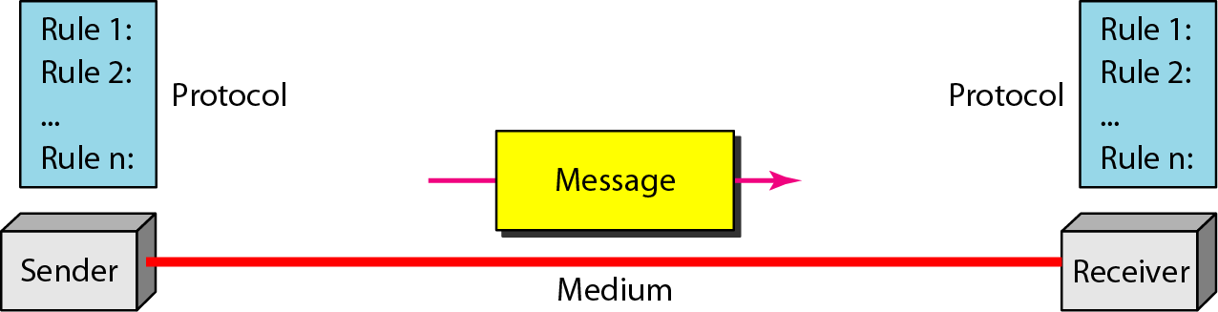
Components of DC System
Message
Sender
Receiver
Transmission Medium
Protocol
10
Notes:
Data Communication

Slide 11
Components of DC System
Message
The message is the information (data) to be communicated.
Popular forms of information include text, numbers, pictures, audio, and video.
Sender
The sender is the device that sends the data message.
It can be a computer, workstation, telephone handset, video camera, and so on.
11
Notes:
Data Communication

Slide 12
Components of DC System
Receiver
The receiver is the device that receives the message.
It can be a computer, workstation, telephone handset, television, and so on.
Transmission Medium
The physical path by which a message travels from sender to receiver.
Some examples of transmission media include twisted-pair wire, coaxial cable, fiber-optic cable, and radio waves.
12
Notes:
Data Communication

Slide 13
Components of DC System
Protocol
A set of rules that govern data communications.
It represents an agreement between the communicating devices.
Without a protocol, two devices may be connected but not communicating,
For instance, a person speaking French cannot be understood by a person who speaks only Japanese.
13
Notes:
Data Communication

Slide 14
A protocol performs the following functions:
Data sequencing
It refers to breaking a long message into smaller packets of fixed size.
Data sequencing rules define the method of numbering packets to detect loss or duplication of packets, and to correctly identify packets, which belong to same message.
Data routing
Data routing defines the most efficient path between the source and destination.
14
Notes:
Data Communication

Slide 15
A protocol performs the following functions:
Data formatting Data formatting rules define which group of bits or characters within packet constitute data, control, addressing, or other information.
Flow control A communication protocol also prevents a fast sender from overwhelming a slow receiver. It ensures resource sharing and protection against traffic congestion by regulating the flow of data on communication lines.
15
Notes:
Data Communication

Slide 16
A protocol performs the following functions:
Error control These rules are designed to detect errors in messages and to ensure transmission of correct messages. The most common method is to retransmit erroneous message block. In such a case, a block having error is discarded by the receiver and is retransmitted by the sender.
Precedence and order of transmission These rules ensure that all the nodes get a chance to use the communication lines and other resources of the network based on the priorities assigned to them.
16
Notes:
Data Communication

Slide 17
A protocol performs the following functions:
Connection establishment and termination These rules define how connections are established, maintained and terminated when two nodes of a network want to communicate with each other.
Data security Providing data security and privacy is also built into most communication software packages. It prevents access of data by unauthorized users.
(https for instance)
17
Notes:
Data Communication

Slide 18

A protocol performs the following functions:
Log information Several communication software are designed to develop log information, which consists of all jobs and data communications tasks that have taken place. Such information may be used for charging the users of the network based on their usage of the network resources.
18
Notes:
Data Communication

Slide 19
Data Representation
Information today comes in different forms such as
Text,
Numbers,
Images,
Audio, and
Video.
19
Notes:
Data Communication

Slide 20
1. Text
Text is represented as a bit pattern, a sequence of bits (Os or 1s).
Different sets of bit patterns have been designed to represent text symbols.
Each set is called a code, and the process of representing symbols is called coding.
Today, the prevalent coding system is called Unicode, which uses 32 bits to represent a symbol or character used in any language in the world.
20
Notes:
Data Communication

Slide 21
1. Text
The American Standard Code for Information Interchange (ASCII), developed some decades ago in the United States
ASCII chart
21
Notes:
Data Communication

Slide 22
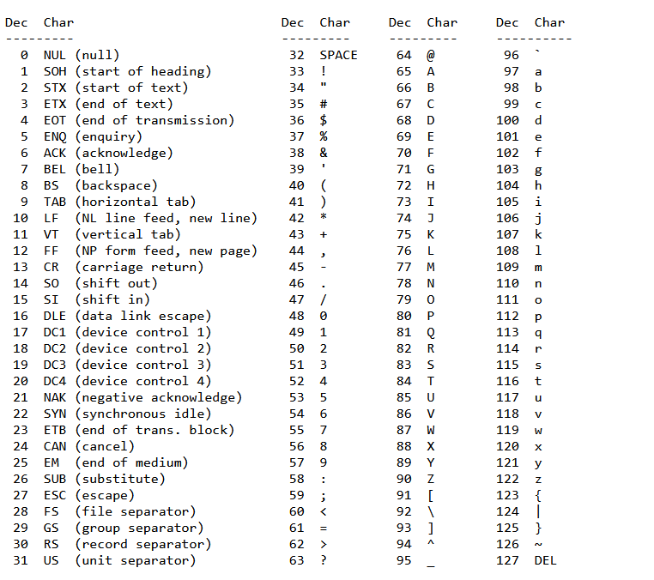

Slide 23
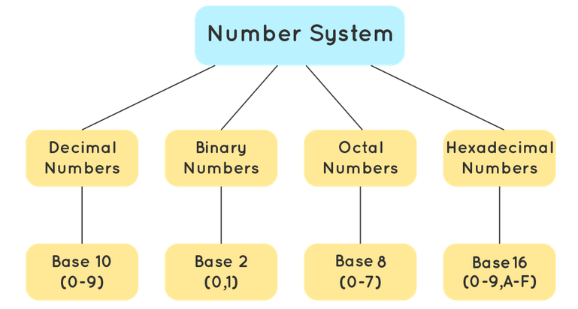
2. Numbers
Numbers are also represented by bit patterns.
However, a code such as ASCII is not used to represent numbers;
The number is directly converted to a binary number to simplify mathematical operations
23
Notes:
Data Communication

Slide 24
3. Images
Images are also represented by bit patterns.
In its simplest form, an image is composed of a matrix of pixels (picture elements), where each pixel is a small dot.
The size of the pixel depends on the resolution. For example, an image can be divided into 1000 pixels or 10,000 pixels.
In the second case, there is a better representation of the image (better resolution), but more memory is needed to store the image.
24
Notes:
Data Communication

Slide 25
3. Images
After an image is divided into pixels, each pixel is assigned a bit pattern.
The size and the value of the pattern depend on the image.
For an image made of only black-and-white dots (e.g., a chessboard), a 1-bit pattern is enough to represent a pixel.
If an image is not made of pure white and pure black pixels, you can increase the size of the bit pattern to include gray scale.
25
Notes:
Data Communication

Slide 26
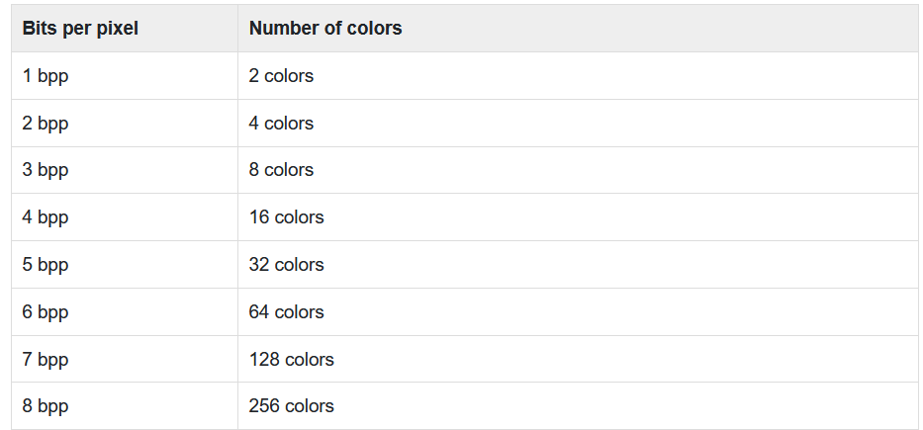
3. Images
3
How many numbers can be represented by one bit - 0, 1
How many two bits combinations can be made - 00, 01, 10, 11
26
Notes:
Data Communication

Slide 27
3. Images
For Example
To show four levels of gray scale, you can use 2-bit patterns.
A black pixel can be represented by 00,
A dark gray pixel by 01,
A light gray pixel by 10, and
A white pixel by 11.
27
Notes:
Data Communication

Slide 28
3. Images
There are several methods to represent color images.
The intensity of each color is measured, and a bit pattern is assigned to it.
One method is called RGB, so called because each color is made of a combination of three primary colors: red, green, and blue.
Another method is called YCM, in which a color is made of a combination of three other primary colors: yellow, cyan, and magenta.
28
Notes:
Data Communication

Slide 29
4. Audio
Audio refers to the recording or broadcasting of sound or music.
Audio is by nature different from text, numbers, or images.
It is continuous, not discrete.
Even when we use a microphone to change voice or music to an electric signal, we create a continuous signal.
we learn how to change sound or music to a digital or an analog signal.
29
Notes:
Data Communication

Slide 30
5. Video
Video refers to the recording or broadcasting of a picture or movie.
Video can either be produced as a continuous entity (e.g., by a TV camera), or it can be a combination of images, each a discrete entity, arranged to convey the idea of motion.
We can change video to a digital or an analog signal.
30
Notes:
Data Communication

Slide 31
Data Flow
Communication between two devices can be
Simplex
Half-Duplex
Full-Duplex
31
Notes:
Data Communication

Slide 32
Simplex
The communication is unidirectional, as on a one-way street
Only one of the two devices on a link can transmit; the other can only receive (see Figure)
Keyboards and traditional monitors are examples of simplex devices.
The keyboard can only introduce input; the monitor can only accept output.
The simplex mode can use the entire capacity of the channel to send data in one direction.
32
Notes:
Data Communication

Slide 33
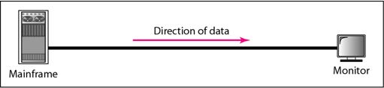
Simplex
If all we want to do is send information one-way, then simplex is just fine.
33
Notes:
Data Communication

Slide 34

Half-Duplex
Each station can both transmit and receive, but not at the same time
When one device is sending, the other can only receive, and vice versa
34
Notes:
Data Communication

Slide 35
Half-Duplex
The half-duplex mode is like a one-lane road with traffic allowed in both directions.
When cars are traveling in one direction, cars going the other way must wait.
In a half-duplex transmission, the entire capacity of a channel is taken over by whichever of the two devices is transmitting at the time.
35
Notes:
Data Communication

Slide 36
Half-Duplex
Walkie-talkies and CB (citizens band) radios are both half-duplex systems.
The half-duplex mode is used in cases where there is no need for communication in both directions at the same time; the entire capacity of the channel can be utilized for each direction.
36
Notes:
Data Communication

Slide 37

Full-Duplex
both stations can transmit and receive simultaneously
The full-duplex mode is like a two-way street with traffic flowing in both directions at the same time.
37
Notes:
Data Communication

Slide 38
Full-Duplex
In full-duplex mode, signals going in one direction share the capacity of the link with signals going in the other direction.
This sharing can occur in two ways: Either the link must contain two physically separate transmission paths, one for sending and the other for receiving; or the capacity of the channel is divided between signals traveling in both directions
38
Notes:
Data Communication

Slide 39
Full-Duplex
One common example of full-duplex communication is the telephone network.
When two people are communicating by a telephone line, both can talk and listen at the same time.
The full-duplex mode is used when communication in both directions is required all the time.
The capacity of the channel, however, must be divided between the two directions.
39
Notes:
Data Communication

Slide 40

Networks
A network is a set of devices (often referred to as nodes) connected by communication links.
A node can be a computer, printer, or any other device capable of sending and/or receiving data generated by other nodes on the network
Distributed Processing
Most networks use distributed processing, in which a task is divided among multiple computers.
Instead of one single large machine being responsible for all aspects of a process, separate computers handle a subset.
40
Notes:
Data Communication

Slide 41
Network Criteria
A network must be able to meet a certain number of criteria.
The most important of these are
Performance
Reliability and
Security
41
Notes:
Data Communication

Slide 42
Performance
Performance can be measured in many ways, including transit time and response time.
Transit time is the amount of time required for a message to travel from one device to another.
Response time is the elapsed time between an inquiry and a response.
The performance of a network depends on a number of factors, including the number of users, the type of transmission medium, the capabilities of the connected hardware, and the efficiency of the software.
42
Notes:
Data Communication

Slide 43
Performance
Performance is often evaluated by two networking metrics: throughput and delay.
We often need more throughput and less delay.
However, these two criteria are often contradictory.
If we try to send more data to the network, we may increase throughput but we increase the delay because of traffic congestion in the network.
43
Notes:
Data Communication

Slide 44
Reliability
In addition to accuracy of delivery, network reliability is measured by the frequency of failure, the time it takes a link to recover from a failure, and the network's robustness in a catastrophe.
44
Notes:
Data Communication

Slide 45
Security
Network security issues includes
Protecting data from unauthorized access
Protecting data from damage and development
Implementing policies and procedures for recovery from breaches and data losses.
45
Notes:
Data Communication

Slide 46

Physical Structures : Type of Connection
A network is two or more devices connected through links.
A link is a communications pathway that transfers data from one device to another.
For visualization purposes, it is simplest to imagine any link as a line drawn between two points.
For communication to occur, two devices must be connected in some way to the same link at the same time.
There are two possible types of connections: point-to-point and multipoint.
46
Notes:
Data Communication

Slide 47


Point-to-Point
Provides a dedicated link between two devices.
The entire capacity of the link is reserved for transmission between those two devices.
Most p2p connections use an actual length of wire or cable to connect the two ends, but other options, such as microwave or satellite links, are also possible(see Figure )
47
Notes:
Data Communication

Slide 48
Point-to-Point
When you change television channels by infrared remote control, you are establishing a point-to-point connection between the remote control and the television's control system.
48
Notes:
Data Communication

Slide 49
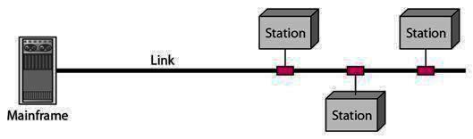

Multipoint
A multipoint (also called multidrop) connection is one in which more than two specific devices share a single link (see Figure)
49
Notes:
Data Communication

Slide 50

Multipoint
In a multipoint environment, the capacity of the channel is shared, either spatially or temporally
If several devices can use the link simultaneously, it is a spatially shared connection
If users must take turns, it is a timeshared connection
50
Notes:
Data Communication

Slide 51



Physical Topology
Topology refers to the way in which a network is laid out physically.
Two or more devices connect to a link; two or more links form a topology.
The topology of a network is the geometric representation of the relationship of all the links and linking devices (usually called nodes) to one another.
There are four basic topologies possible.
51
Notes:
Data Communication

Slide 52
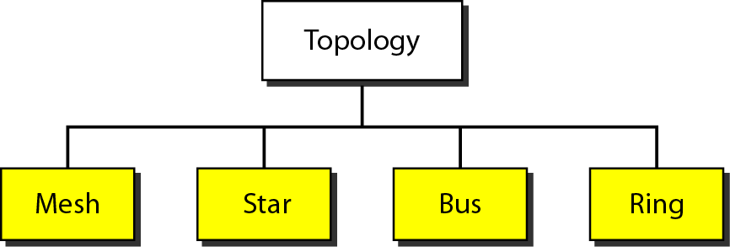
Categories of topology
52
Notes:
Data Communication

Slide 53
Mesh Topology
Every device has a dedicated point-to-point link to every other device.
The term dedicated means that the link carries traffic only between the two devices it connects.
To find the number of physical links in a fully connected mesh network with n nodes,
We first consider that each node must be connected to every other node.
Node 1 must be connected to n - I nodes, node 2 must be connected to n – 1 nodes, and finally node n must be connected to n - 1 nodes.
53
Notes:
Data Communication

Slide 54
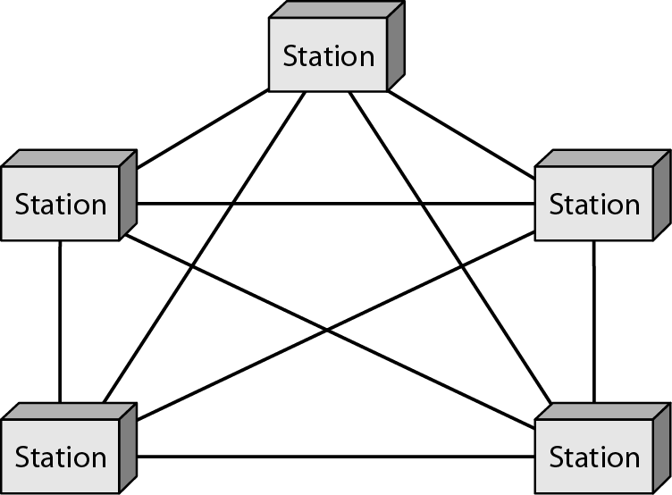
A fully connected mesh topology (five devices)
54
Notes:
Data Communication

Slide 55
Advantages
The use of dedicated links guarantees that each connection can carry its own data load, thus eliminating the traffic problems that can occur when links must be shared by multiple devices.
Robust If one link becomes unusable, it does not incapacitate the entire system.
Privacy or security When every message travels along a dedicated line, only the intended recipient sees it. Physical boundaries prevent other users from gaining access to messages.
55
Notes:
Data Communication

Slide 56
Advantages
Point-to-point links make fault identification and fault isolation easy.
Traffic can be routed to avoid links with suspected problems.
56
Notes:
Data Communication

Slide 57
Disadvantages
The amount of cabling and the number of I/O ports required. Because every device must be connected to every other device, installation and reconnection are difficult.
The sheer bulk of the wiring can be greater than the available space (in walls, ceilings, or floors) can accommodate.
The hardware required to connect each link (I/O ports and cable) can be prohibitively expensive.
57
Notes:
Data Communication

Slide 58
Mesh Topology
For these reasons a mesh topology is usually implemented in a limited fashion, for example, as a backbone connecting the main computers of a hybrid network that can include several other topologies.
One practical example of a mesh topology is the connection of telephone regional offices in which each regional office needs to be connected to every other regional office.
58
Notes:
Data Communication

Slide 59
Star Topology
Each device has a dedicated point-to-point link only to a central controller, usually called a hub.
The devices are not directly linked to one another.
Unlike a mesh topology, a star topology does not allow direct traffic between devices.
The controller acts as an exchange: If one device wants to send data to another, it sends the data to the controller, which then relays the data to the other connected device (see Figure)
59
Notes:
Data Communication

Slide 60
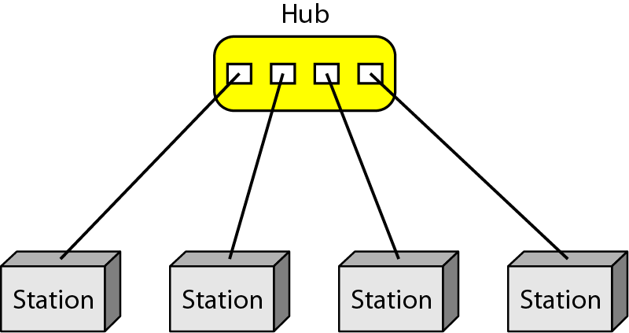
Star Topology
Figure : A star topology connecting four stations
60
Notes:
Data Communication

Slide 61
Star Topology : Advantages
A star topology is less expensive than a mesh topology.
In a star, each device needs only one link and one I/O port to connect it to any number of others.
This factor also makes it easy to install and reconfigure.
Far less cabling needs to be housed, and additions, moves, and deletions involve only one connection: between that device and the hub.
61
Notes:
Data Communication

Slide 62
Star Topology : Advantages
Robustness
If one link fails, only that link is affected.
All other links remain active.
This factor also lends itself to easy fault identification and fault isolation.
As long as the hub is working, it can be used to monitor link problems and bypass defective links.
62
Notes:
Data Communication

Slide 63
Star Topology : Disadvantages
Dependency the whole topology on one single point, the hub
If the hub goes down, the whole system is dead.
Although a star requires far less cable than a mesh, each node must be linked to a central hub
For this reason, often more cabling is required in a star than in some other topologies (such as ring or bus).
The star topology is used in local-area networks (LANs) and High-speed LANs often use a star topology with a central hub.
63
Notes:
Data Communication

Slide 64
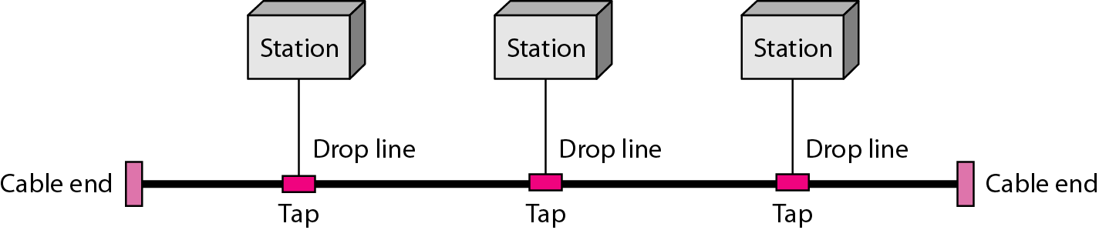
Bus Topology
A bus topology, on the other hand, is multipoint.
One long cable acts as a backbone to link all the devices in a network (see Figure)
Figure : A bus topology connecting three stations
64
Notes:
Data Communication

Slide 65
Bus Topology
Nodes are connected to the bus cable by drop lines and taps.
A drop line is a connection running between the device and the main cable.
A tap is a connector that either slices into the main cable or punctures the sheathing of a cable to create a contact with the metallic core.
As a signal travels along the backbone, some of its energy is transformed into heat.
65
Notes:
Data Communication

Slide 66
Bus Topology
Therefore, it becomes weaker and weaker as it travels farther and farther
For this reason there is a limit on the number of taps a bus can support and on the distance between those taps.
66
Notes:
Data Communication

Slide 67
Bus Topology : Advantages
Ease of Installation
A bus uses less cabling than mesh or star topologies.
In a star, for example, four network devices in the same room require four lengths of cable reaching all the way to the hub.
In a bus, this redundancy is eliminated. Only the backbone cable stretches through the entire facility.
Each drop line has to reach only as far as the nearest point on the backbone.
67
Notes:
Data Communication

Slide 68



Bus Topology : Disadvantages
Difficult reconnection and fault isolation
A bus is usually designed to be optimally efficient at installation.
It can therefore be difficult to add new devices.
Signal reflection at the taps can cause degradation in quality.
This degradation can be controlled by limiting the number and spacing of devices connected to a given length of cable.
Adding new devices may therefore require modification or replacement of the backbone.
68
Notes:
Data Communication

Slide 69

Bus Topology : Disadvantages
In addition, a fault or break in the bus cable stops all transmission, even between devices on the same side of the problem.
The damaged area reflects signals back in the direction of origin, creating noise in both directions.
Bus topology was the one of the first topologies used in the design of early local area networks.
Ethernet LANs can use a bus topology, but they are less popular now.
69
Notes:
Data Communication

Slide 70
Ring Topology
Each device has a dedicated point-to-point connection with only the two devices on either side of it.
A signal is passed along the ring in one direction, from device to device, until it reaches its destination.
Each device in the ring incorporates a repeater.
When a device receives a signal intended for another device, its repeater regenerates the bits and passes them along (see Figure)
70
Notes:
Data Communication

Slide 71
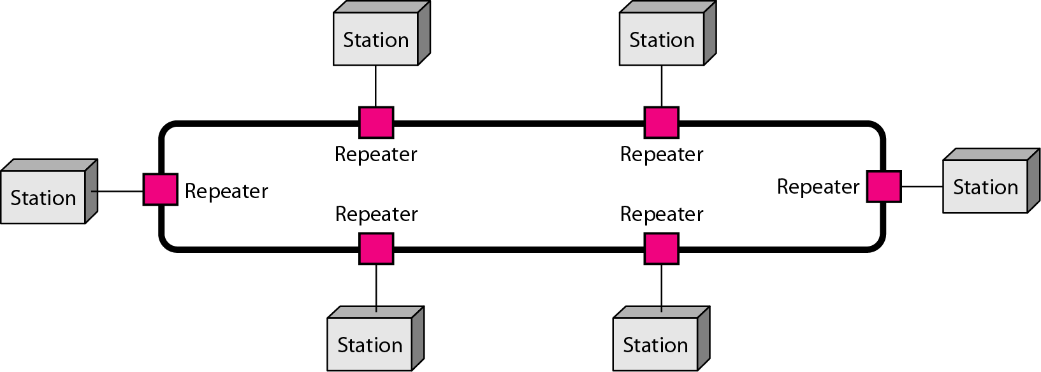
Ring Topology
Figure : A ring topology connecting six stations
71
Notes:
Data Communication

Slide 72
Ring Topology : Advantage
Easy to install and reconfigure
Each device is linked to only its immediate neighbors (either physically or logically).
To add or delete a device requires changing only two connections.
The only constraints are media and traffic considerations (maximum ring length and number of devices)..
72
Notes:
Data Communication

Slide 73
Ring Topology : Advantage
Fault isolation is simplified
Generally in a ring, a signal is circulating at all times.
If one device does not receive a signal within a specified period, it can issue an alarm.
The alarm alerts the network operator to the problem and its location.
73
Notes:
Data Communication

Slide 74
Ring Topology : Disadvantage
Unidirectional traffic
In a simple ring, a break in the ring (such as a disabled station) can disable the entire network.
This weakness can be solved by using a dual ring or a switch capable of closing off the break.
74
Notes:
Data Communication

Slide 75
Ring Topology : Applications
Ring topology was prevalent when IBM introduced its local-area network Token Ring.
Today, the need for higher-speed LANs has made this topology less popular.
75
Notes:
Data Communication

Slide 76
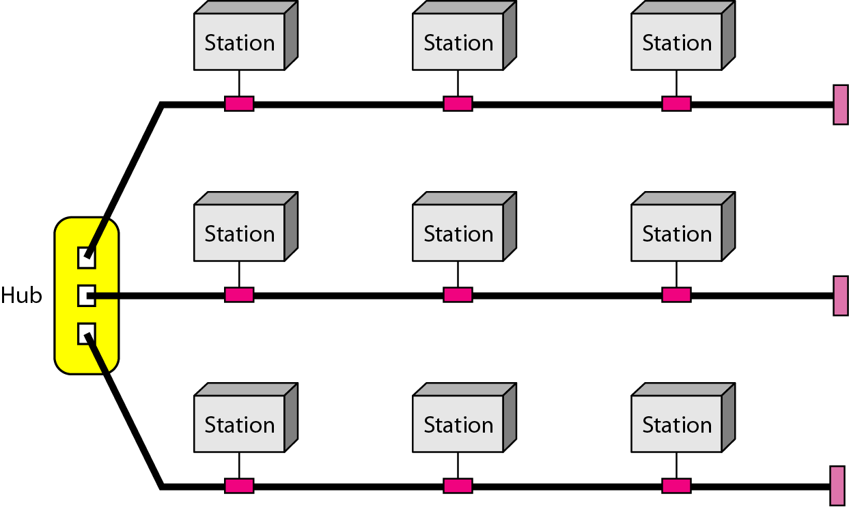
Hybrid Topology
A network can be hybrid. For example, we can have a main star topology with each branch connecting several stations in a bus topology as shown in Figure.
76
Notes:
Data Communication

Slide 77
Network Models
Computer networks are created by different entities.
Standards are needed so that these heterogeneous networks can communicate with one another.
The two best-known standards are the OSI model and the Internet model.
The OSI (Open Systems Interconnection) model defines a seven-layer network;
The Internet model defines a five-layer network.
77
Notes:
Data Communication

Slide 78
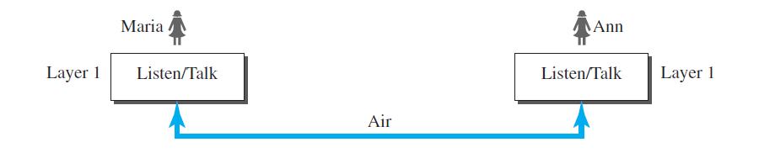





Protocol Layering
When communication is simple, we may need only one simple protocol; when the communication is complex, we may need to divide the task between different layers, in which case we need a protocol at each layer, or protocol layering
Fig. A single layer protocol

Slide 79
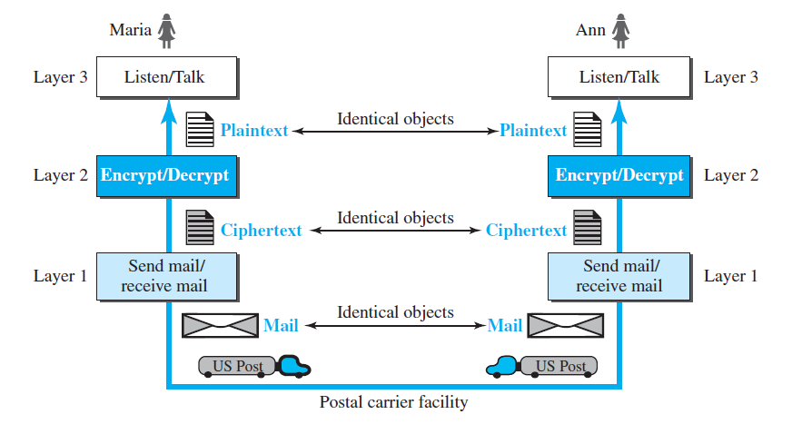
Protocol Layering
Fig. A three-layer protocol

Slide 80



OSI Model
International Organization for Standardization (ISO) is a multinational body
Dedicated to worldwide agreement on international standards.
An ISO standard that covers all aspects of network communications is the Open Systems Interconnection (OSI)
The purpose of the OSI model is to show how to facilitate communication between different systems without requiring changes to the logic of the underlying hardware and software model.
The OSI model is not a protocol; it is a model for understanding and designing a network architecture.

Slide 81
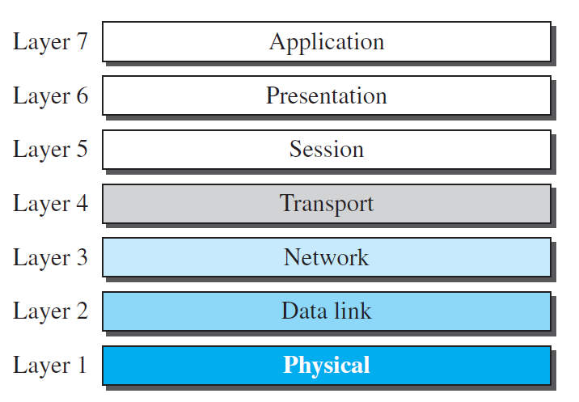
The OSI model

Slide 82
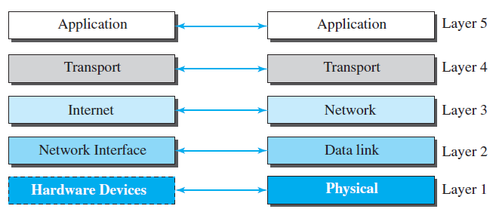
TCP/IP PROTOCOL SUITE
TCP/IP (Transmission Control Protocol/Internet Protocol).
It is a hierarchical protocol made up of interactive modules.
The original TCP/IP protocol suite was defined as four software layers built upon the hardware.
Today, however, TCP/IP is thought of as a five-layer model.

Slide 83
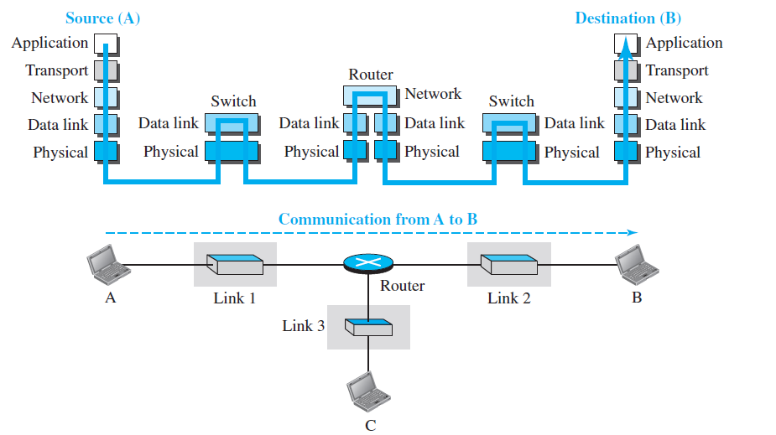
Communication in background

Slide 84
Communication devices
source host (computer A)
link-layer switch in link 1
router
link-layer switch in link 2
destination host (computer B)
The two hosts are involved in all five layers;
The router is involved in only three layers(no transport or application layer in a router)
A link-layer switch in a link, however, is involved only in two layers, data-link and physical.
unlike a router, a link-layer switch is involved only in one data-link and one physical layer.

Slide 85
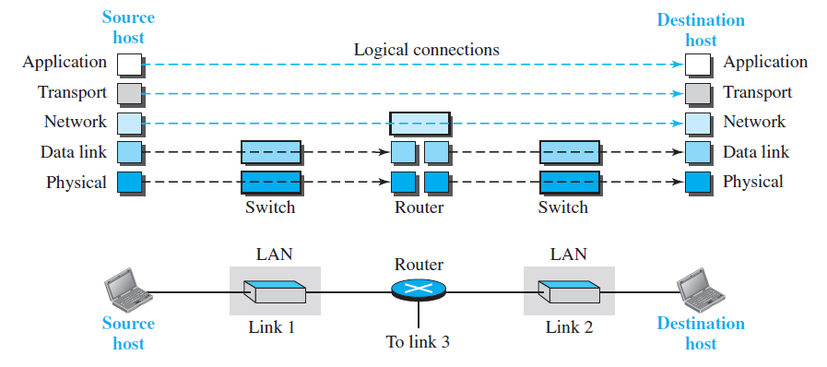
Logical connections between layers of the TCP/IP protocol suite

Slide 86
the duty of the application, transport, and network layers is end-to-end.
the duty of the data-link and physical layers is hop-to-hop, in which a hop is a host or router
the domain of duty of the top three layers is the internet, and the domain of duty of the two lower layers is the link

Slide 87
Physical Layer
The physical layer is responsible for carrying individual bits in a frame across the link
Two devices are connected by a transmission medium
the logical unit between two physical layers in two devices is a bit.
Bit is converted to signal.

Slide 88
Data Link Layer
The data-link layer is responsible for taking the datagram and moving it across the best available link.
TCP/IP does not define any specific protocol for the data-link layer. It supports all the standard and proprietary protocols. Any protocol that can take the datagram and carry it through the link suffices for the network layer.
The data-link layer takes a datagram and encapsulates it in a packet called a frame

Slide 89
Network Layer
creating a connection between the source computer and the destination computer.
communication at the network layer is host-to-host
network layer is responsible for host-to-host communication and routing the packet through possible routes
The network layer in the Internet includes the main protocol, Internet Protocol (IP), that defines the format of the packet, called a datagram at the network layer.
IP is also responsible for routing a packet from its source to its destination, which is achieved by each router forwarding the datagram to the next router in its path.
The network layer also includes unicast (one-to-one) and multicast (one-to-many) routing protocols.
A routing protocol does not take part in routing (it is the responsibility of IP), but it creates forwarding tables for routers to help them in the routing process.

Slide 90
Protocols in NL
The Internet Control Message Protocol (ICMP) helps IP to report some problems when routing a packet.
The Internet Group Management Protocol (IGMP) is another protocol that helps IP in multitasking.
The Dynamic Host Configuration Protocol (DHCP) helps IP to get the network-layer address for a host.

Slide 91
Transport Layer
The logical connection at the transport layer is also end-to-end.
The transport layer at the source host gets the message from the application layer, encapsulates it in a transport layer packet (called a segment or a user datagram in different protocols) and sends it, through the logical (imaginary) connection, to the transport layer at the destination host.
The transport layer is responsible for giving services to the application layer: to get a message from an application program running on the source host and deliver it to the corresponding application program on the destination host.
The transport layer should be independent of the application layer

Slide 92
TL protocols
Transmission Control Protocol (TCP), is a connection-oriented protocol
User Datagram Protocol (UDP), is a connectionless protocol
A new protocol, Stream Control Transmission Protocol (SCTP) is designed to respond to new applications that are emerging in the multimedia

Slide 93
Application Layer
The two application layers exchange messages between each other as though there were a bridge between the two layers.
However, communication is done through all layers.
Communication at the application layer is between two processes
Process-to-process communication is the duty of the application layer.

Slide 94
AL protocols
The Hypertext Transfer Protocol (HTTP) is a vehicle for accessing the World Wide Web (WWW).
The Simple Mail Transfer Protocol (SMTP) is the main protocol used in electronic mail (e-mail) service.
The File Transfer Protocol (FTP) is used for transferring files from one host to another.
The Terminal Network (TELNET) and Secure Shell (SSH) are used for accessing a site remotely.
The Simple Network Management Protocol (SNMP) is used by an administrator to manage the Internet at global and local levels.
The Domain Name System (DNS) is used by other protocols to find the network-layer address of a computer.

Slide 95
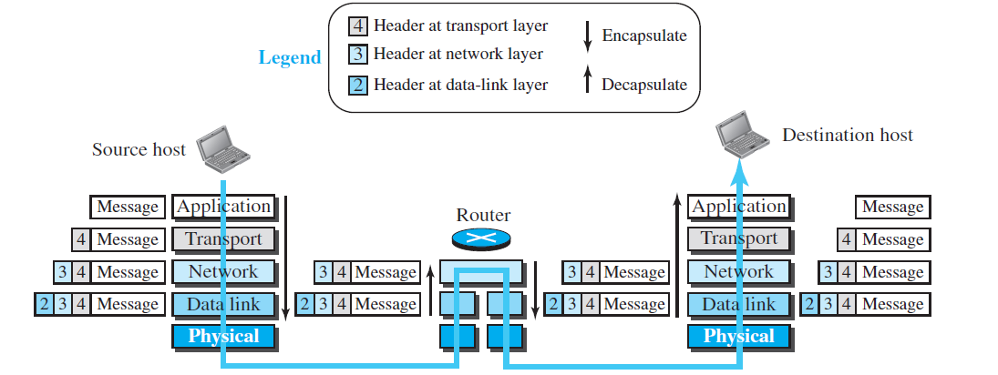
Encapsulation and Decapsulation

Slide 96
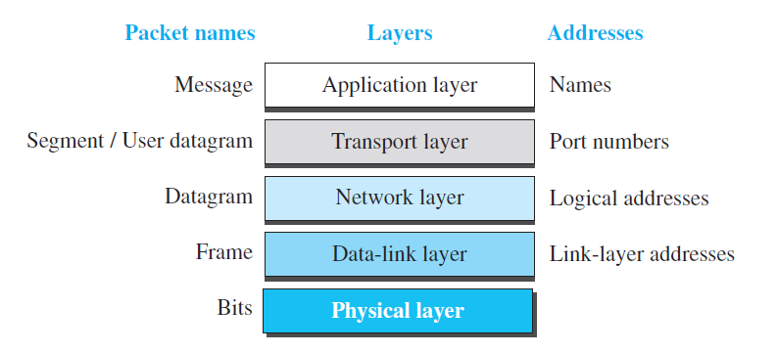
Addressing in the TCP/IP protocol suite

Slide 97
Categories of Networks
Today when we speak of networks, we are generally referring to two primary categories: Local-area networks and wide-area networks.
The category into which a network falls is determined by its size.
A LAN normally covers an area less than 2 miters; a WAN can be worldwide.
Networks of a size in between are normally referred to as metropolitan area networks and span tens of miles.
97
Notes:
Data Communication

Slide 98
Local Area Network
A local area network (LAN) is usually privately owned and connects some hosts in a single office, building, or campus.
Can be as simple as two PCs and a printer in someone’s home office, or it can extend throughout a company and include audio and video devices.
Currently, LAN size is limited to a few kilometers.
98
Notes:
Data Communication

Slide 99
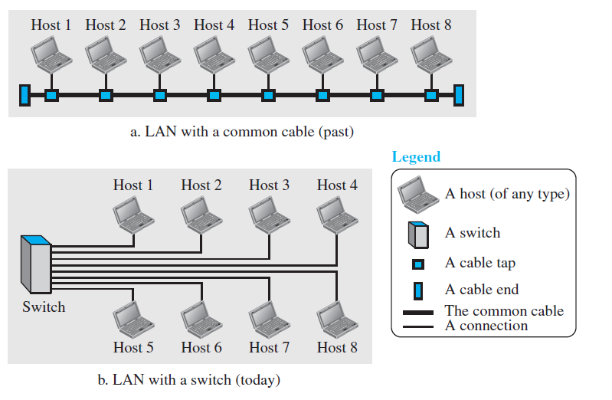
Local Area Network
Local Area Network
99
Notes:
Data Communication

Slide 100
Local Area Network
LANs are designed to allow resources to be shared between personal computers or workstations.
The resources to be shared can include hardware (e.g., a printer), software (e.g., an application program), or data.
A common example of a LAN, found in many business environments, links a workgroup of task-related computers, for example, engineering workstations or accounting PCs.
One of the computers may be given a large capacity disk drive and may become a server to clients.
100
Notes:
Data Communication

Slide 101
Local Area Network
Software can be stored on this central server and used as needed by the whole group.
In this example, the size of the LAN may be determined by licensing restrictions on the number of users per copy of software, or by restrictions on the number of users licensed to access the operating system.
Chapter 1 same as book, read chapter 2 and solve book exercise
101
Notes:
Data Communication

Slide 102

Local Area Network
LANs are distinguished from other types of networks by their transmission media and topology.
In general, a given LAN will use only one type of transmission medium.
The most common LAN topologies are bus, ring, and star.
Early LANs had data rates in the 4 to 16 megabits per second (Mbps) range.
Today, speeds are normally 100 or 1000 Mbps.
Wireless LANs are the newest evolution in LAN technology
102
Notes:
Data Communication

Slide 103
Wide Area Network
WAN provides long-distance transmission of data, image, audio, and video information over large geographic areas that may comprise a country, a continent, or even the whole world
A WAN can be as complex as the backbones that connect the Internet or as simple as a dial-up line that connects a home computer to the Internet
We normally refer to the first as a switched WAN and to the second as a point-to-point WAN (Figure )
103
Notes:
Data Communication

Slide 104
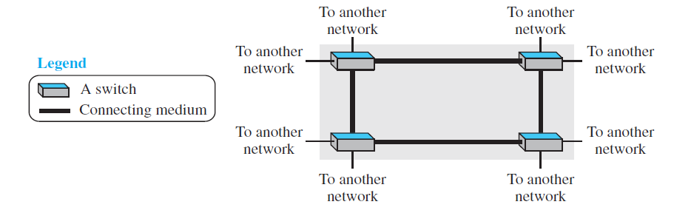
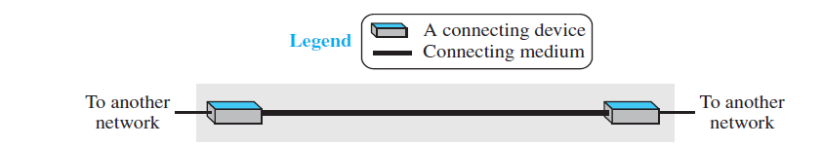
Wide Area Network
Fig A Switched WAN
Fig B Point to Point WAN
104
Notes:
Data Communication

Slide 105

Wide Area Network
The switched WAN connects the end systems, which usually comprise a router (internetworking connecting device) that connects to another LAN or WAN.
The point-to-point WAN is normally a line leased from a telephone or cable TV provider that connects a home computer or a small LAN to an Internet service provider (lSP).
This type of WAN is often used to provide Internet access.
105
Notes:
Data Communication

Slide 106
Metropolitan Area Networks
MAN is a network with a size between a LAN and a WAN.
It normally covers the area inside a town or a city.
It is designed for customers who need a high-speed connectivity, normally to the Internet, and have endpoints spread over a city or part of city.
A good example of a MAN is the part of the telephone company network that can provide a high-speed DSL line to the customer.
106
Notes:
Data Communication

Slide 107
Metropolitan Area Networks
Another example is the cable TV network that originally was designed for cable TV, but today can also be used for high-speed data connection to the Internet
107
Notes:
Data Communication

Slide 108
Interconnection of Networks: Internetwork
Today, it is very rare to see a LAN, a MAN, or a LAN in isolation; they are connected to one another.
When two or more networks are connected, they become an internetwork, or internet.
108
Notes:
Data Communication

Slide 109
Internetwork : Example
Assume that an organization has two offices, one on the east coast and the other on the west coast.
The established office on the west coast has a bus topology LAN; the newly opened office on the east coast has a star topology LAN.
The president of the company lives somewhere in the middle and needs to have control over the company from her home.
To create a backbone WAN for connecting these three entities (two LANs and the president's computer), a switched WAN (operated by a service provider such as a telecom company) has been leased.
109
Notes:
Data Communication

Slide 110
Internetwork : Example
To connect the LANs to this switched WAN, however, three point-to-point WANs are required.
These point-to-point WANs can be a high-speed DSL line offered by a telephone company or a cable modern line offered by a cable TV provider as shown in Figure.
110
Notes:
Data Communication

Slide 111
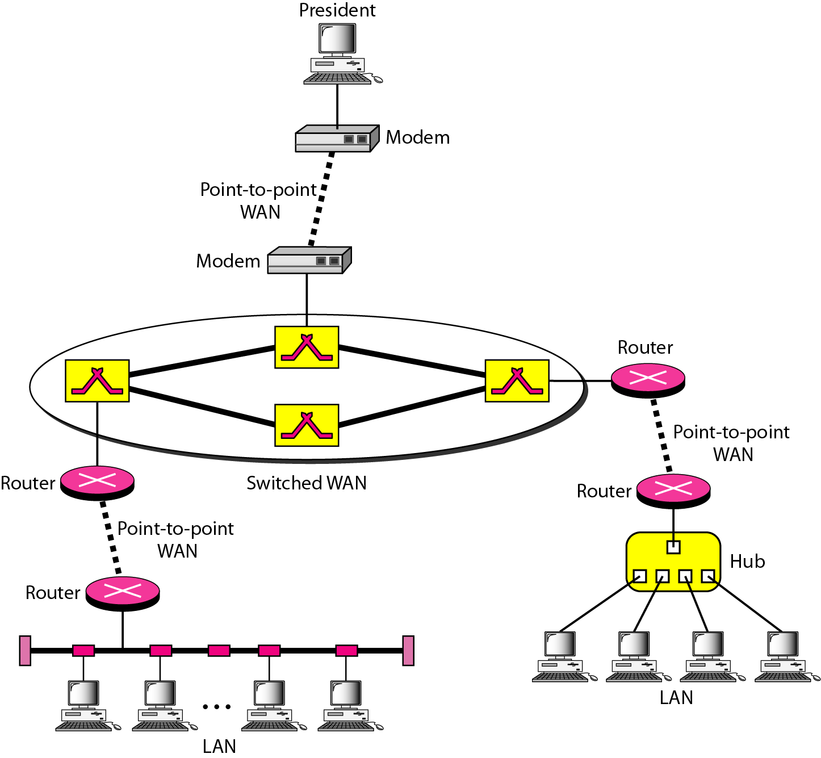
Internetwork : Example
111
Notes:
Data Communication

Slide 112
The Internet
The Internet has revolutionized many aspects of our daily lives.
Email,
Utility Bill
News
Research
Hotel Booking / Ticket Booking
Communication
112
Notes:
Data Communication

Slide 113
The Internet
The Internet is a communication system that has brought a wealth of information to our fingertips and organized it for our use.
The Internet is a structured, organized system.
113
Notes:
Data Communication

Slide 114
The Internet Today
The Internet has come a long way since the 1960s.
The Internet today is not a simple hierarchical structure.
It is made up of many wide- and local-area networks joined by connecting devices and switching stations.
It is difficult to give an accurate representation of the Internet because it is continually changing-new networks are being added, existing networks are adding addresses, and networks of defunct companies are being removed.
114
Notes:
Data Communication

Slide 115


The Internet Today
Today most end users who want Internet connection use the services of Internet service providers (lSPs).
There are international service providers, national service providers, regional service providers, and local service providers.
The Internet today is run by private companies, not the government.
Figure shows a conceptual (not geographic) view of the Internet.
115
Notes:
Data Communication

Slide 116
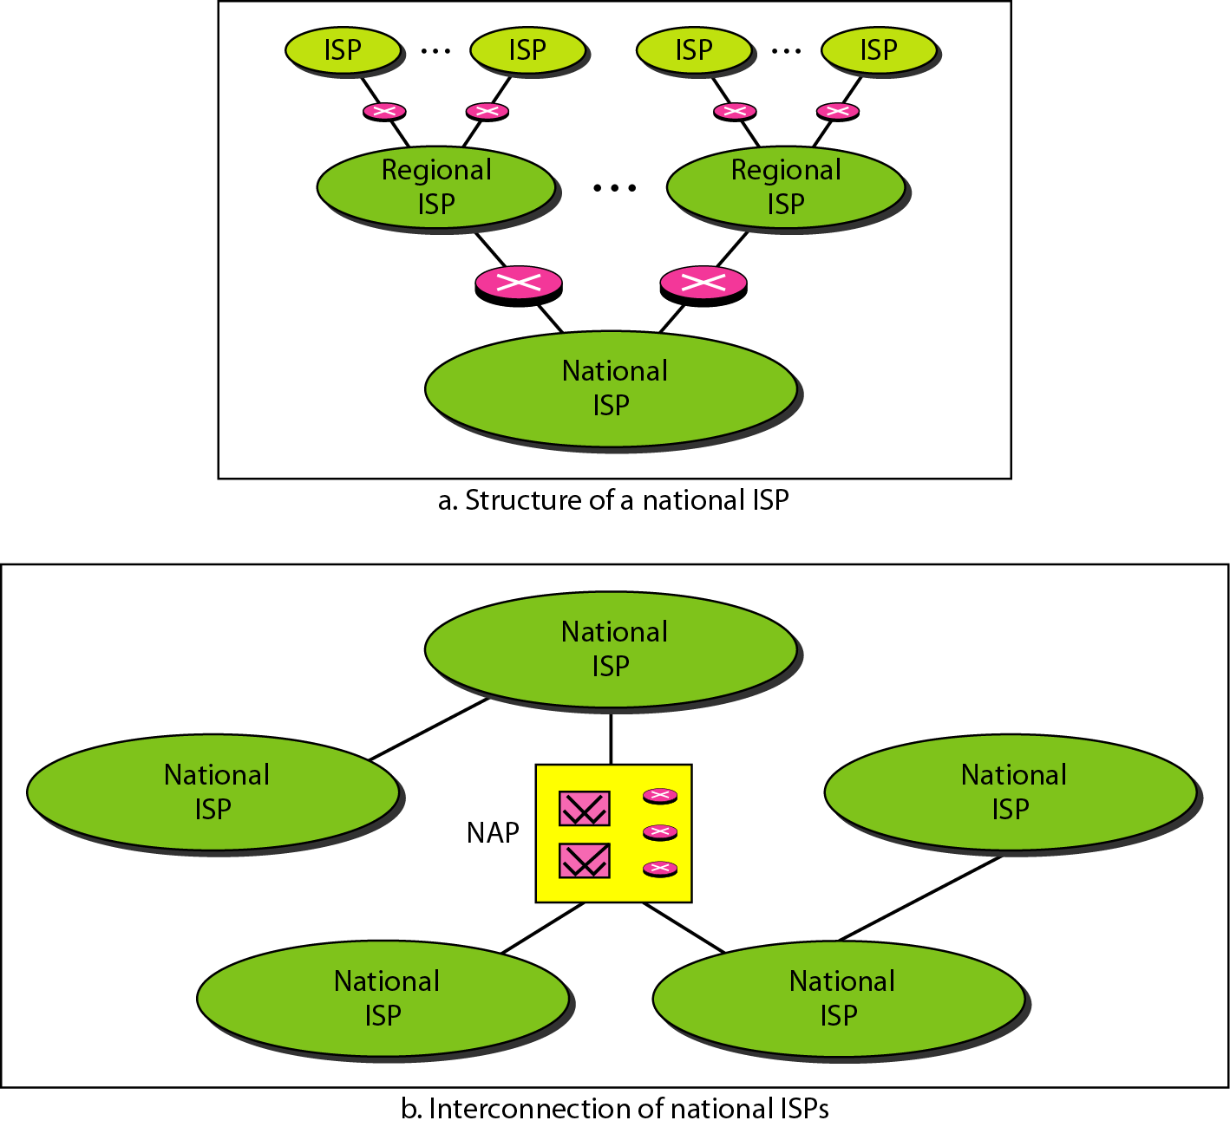
The Internet Today
116
Notes:
Data Communication

Slide 117
International Internet Service Providers
At the top of the hierarchy are the international service providers that connect nations together.
117
Notes:
Data Communication

Slide 118
National Internet Service Providers
These are backbone networks created and maintained by specialized companies.
There are many national ISPs operating in North America; some of the most well known are SprintLink, PSINet, UUNet Technology, AGIS, and internet Mel.
To provide connectivity between the end users, these backbone networks are connected by complex switching stations (normally run by a third party) called network access points (NAPs).
118
Notes:
Data Communication

Slide 119
National Internet Service Providers
Some national ISP networks are also connected to one another by private switching stations called peering points.
These normally operate at a high data rate (up to 600 Mbps).
119
Notes:
Data Communication

Slide 120
Regional Internet Service Providers
Regional internet service providers or regional ISPs are smaller ISPs that are connected to one or more national ISPs.
They are at the third level of the hierarchy with a smaller data rate.
120
Notes:
Data Communication

Slide 121
Local Internet Service Providers
Local Internet service providers provide direct service to the end users.
The local ISPs can be connected to regional ISPs or directly to national ISPs.
Most end users are connected to the local ISPs.
Note that in this sense, a local ISP can be a company that just provides Internet services, a corporation with a network that supplies services to its own employees, or a nonprofit organization, such as a college or a university, that runs its own network.
121
Notes:
Data Communication

Slide 122
Local Internet Service Providers
Each of these local ISPs can be connected to a regional or national service provider.
122
Notes:
Data Communication

Slide 123
Protocols and Standards
In this section, we define two widely used terms: protocols and standards.
First, we define protocol, which is synonymous with rule.
Then we discuss standards, which are agreed-upon rules.
123
Notes:
Data Communication

Slide 124
Protocols
In computer networks, communication occurs between entities in different systems.
An entity is anything capable of sending or receiving information.
However, two entities cannot simply send bit streams to each other and expect to be understood.
For communication to occur, the entities must agree on a protocol.
124
Notes:
Data Communication

Slide 125
Protocols
A protocol defines what is communicated, how it is communicated, and when it is communicated.
The key elements of a protocol are
Syntax,
Semantics, and
Timing.
125
Notes:
Data Communication

Slide 126



Syntax
It refers to the structure or format of the data, meaning the order in which they are presented.
For example, a simple protocol might expect the first 8 bits of data to be the address of the sender, the second 8 bits to be the address of the receiver, and the rest of the stream to be the message itself.
126
Notes:
Data Communication

Slide 127


Semantics
The word semantics refers to the meaning of each section of bits.
How is a particular pattern to be interpreted, and what action is to be taken based on that interpretation?
For example, does an address identify the route to be taken or the final destination of the message?
127
Notes:
Data Communication

Slide 128
Timing
The term timing refers to two characteristics: when data should be sent and how fast they can be sent.
For example, if a sender produces data at 100 Mbps but the receiver can process data at only 1 Mbps, the transmission will overload the receiver and some data will be lost.
128
Notes:
Data Communication

Slide 129
Standards
Standards are essential in creating and maintaining an open and competitive market for equipment manufacturers and in guaranteeing national and international interoperability of data and telecommunications technology and processes.
Standards provide guidelines to manufacturers, vendors, government agencies, and other service providers to ensure the kind of interconnectivity necessary in today's marketplace and in international communications.
129
Notes:
Data Communication

Slide 130
Standards Organizations
International Organization for Standardization (ISO)
International Telecommunication Union-Telecommunication Standards Sector (ITU-T)
American National Standards Institute (ANSI)
Institute of Electrical and Electronics Engineers (IEEE)
Electronic Industries Association (EIA)
130
Notes:
Data Communication

Slide 131
Introduction to Physical Layer

Slide 132
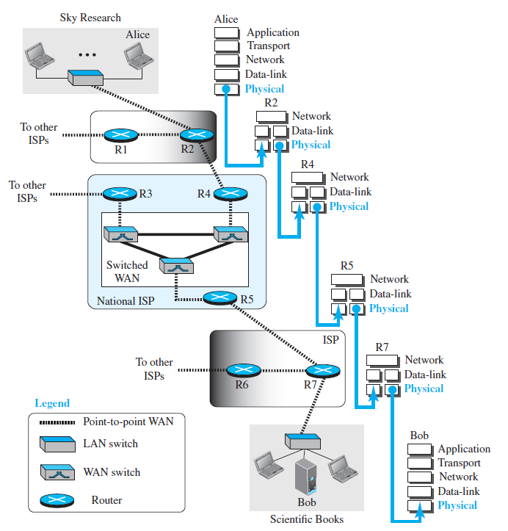

Slide 133
Analog and Digital data
The term analog data refers to information that is continuous;
For example, an analog clock that has hour, minute, and second hands gives information in a continuous form; the movements of the hands are continuous.
Digital data refers to information that has discrete states. On the other hand, a digital clock that reports the hours and the minutes will change suddenly from 8:05 to 8:06.

Slide 134
PERIODIC ANALOG SIGNALS
Periodic analog signals can be classified as simple or composite.
A simple periodic analog signal, a sine wave, cannot be decomposed into simpler signals.
A composite periodic analog signal is composed of multiple sine waves.

Slide 135
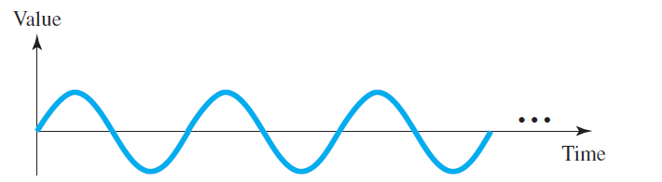
Sine Wave
The sine wave is the most fundamental form of a periodic analog signal.
When we visualize it as a simple oscillating curve, its change over the course of a cycle is smooth and consistent, a continuous, rolling flow.
A sine wave can be represented by three parameters: the peak amplitude, the frequency, and the phase. These three parameters fully describe a sine wave.

Slide 136
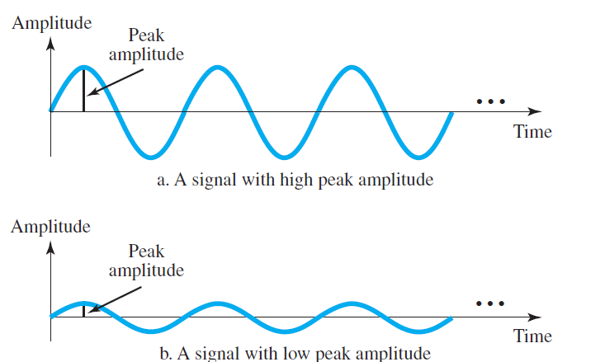
Sine Wave
The peak amplitude of a signal is the absolute value of its highest intensity, proportional to the energy it carries. For electric signals, peak amplitude is normally measured in volts.

Slide 137
Sine Wave
The peak amplitude of a signal is the absolute value of its highest intensity, proportional to the energy it carries. For electric signals, peak amplitude is normally measured in volts.
The voltage of a battery is a constant; this constant value can be considered a sine wave. For example, the peak value of an AA battery is normally 1.5 V

Slide 138
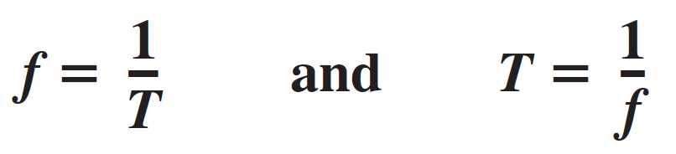
Sine Wave
Period refers to the amount of time, in seconds, a signal needs to complete 1 cycle.
Frequency refers to the number of periods in 1 s.
Note that period and frequency are just one characteristic defined in two ways.
Period is the inverse of frequency, and frequency is the inverse of period.
Frequency is formally expressed in Hertz (Hz)

Slide 139
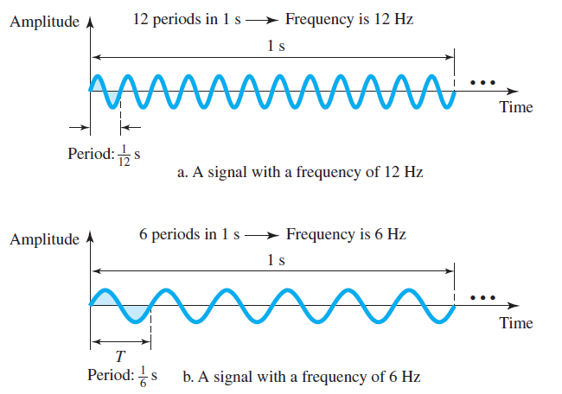
Sine Wave
same amplitude and phase, but different frequencies

Slide 140
Frequency is the rate of change with respect to time.
Change in a short span of time means high frequency.
Change over a long span of time means low frequency.
If a signal does not change at all, its frequency is zero.
If a signal changes instantaneously, its frequency is infinite.

Slide 141
Sine Wave
The term phase, or phase shift, describes the position of the waveform relative to time 0.
If we think of the wave as something that can be shifted backward or forward along the time axis, phase describes the amount of that shift. It indicates the status of the first cycle.
Phase is measured in degrees or radians.

Slide 142
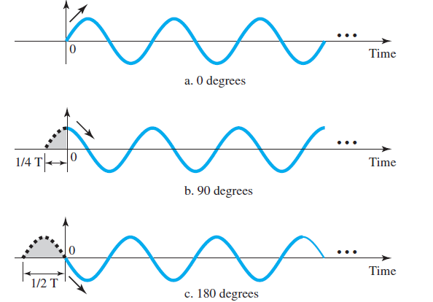
A sine wave with a phase of 0° starts at time 0 with a zero amplitude. The amplitude is increasing. A sine wave with a phase of 0° is not shifted.
A sine wave with a phase of 90° starts at time 0 with a peak amplitude. The amplitude is decreasing. A sine wave with a phase of 90° is shifted to the left by ¼ cycle.
A sine wave with a phase of 180° starts at time 0 with a zero amplitude. The amplitude is decreasing. A sine wave with a phase of 180° is shifted to the left by ½ cycle.

Slide 143
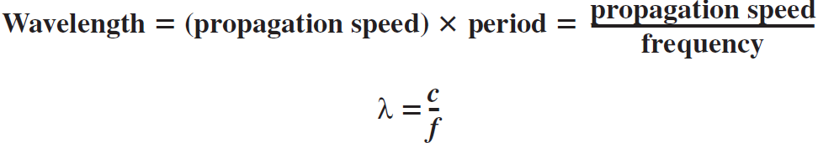
Wavelength is another characteristic of a signal traveling through a transmission medium.
Wavelength binds the period or the frequency of a simple sine wave to the propagation speed of the medium.
Wavelength depends on both the frequency and the medium.
It describes the transmission of light in an optical fiber.
The wavelength is the distance a simple signal can travel in one period.

Slide 144



The range of frequencies contained in a composite signal is its bandwidth.
The bandwidth is normally a difference between two numbers. For example, if a composite signal contains frequencies between 1000 and 5000, its bandwidth is 5000 − 1000, or 4000.

Slide 145
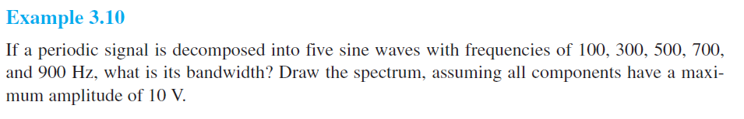
Examples

Slide 146
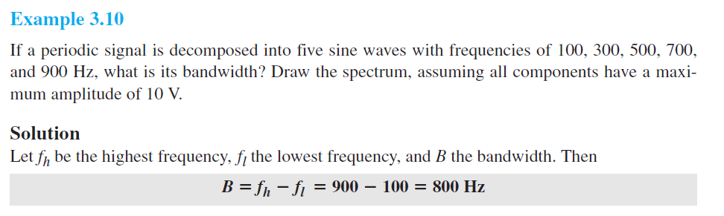
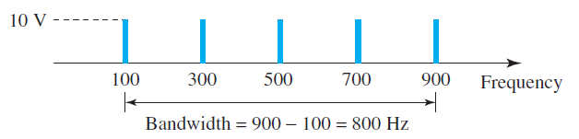
Examples

Slide 147
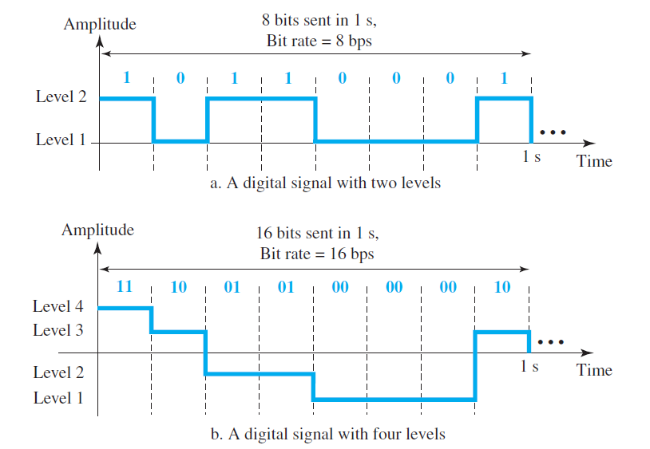
DIGITAL SIGNALS

Slide 148

Digital Signals
The bit rate is the number of bits sent in 1s, expressed in bits per second (bps)
Bit rate works instead of frequency(in analog signals).
The bit length is the distance one bit occupies on the transmission medium.
Bit length works instead of wavelength(in analog signals).

Slide 149
Transmission of Digital Signals
The fundamental question is, How can we send a digital signal from point A to point B?
We can transmit a digital signal by using one of two different approaches:
baseband transmission
broadband transmission (using modulation).

Slide 150
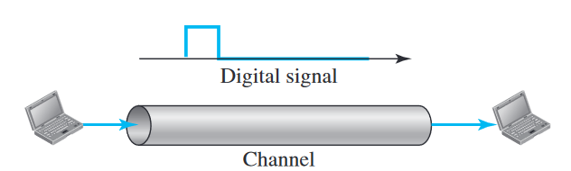
Baseband Transmission
Baseband transmission means sending a digital signal over a channel without changing the digital signal to an analog signal.

Slide 151
Baseband Transmission
Baseband transmission requires that we have a low-pass channel, a channel with a bandwidth that starts from zero.
This is the case if we have a dedicated medium with a bandwidth constituting only one channel. For example, the entire bandwidth of a cable connecting two computers is one single channel.

Slide 152
TRANSMISSION IMPAIRMENT
The imperfection in transmission medium causes signal impairment.
The signal at the beginning of the medium is not the same as that at the end.
Three causes of impairment are attenuation, distortion, and noise.

Slide 153







Attenuation
Attenuation means a loss of energy.
When a signal, simple or composite, travels through a medium, it loses some of its energy in overcoming the resistance of the medium.
That is why a wire carrying electric signals gets warm, if not hot, after a while.
Some of the electrical energy in the signal is converted to heat.
To compensate for this loss, amplifiers are used to amplify the signal.

Slide 154
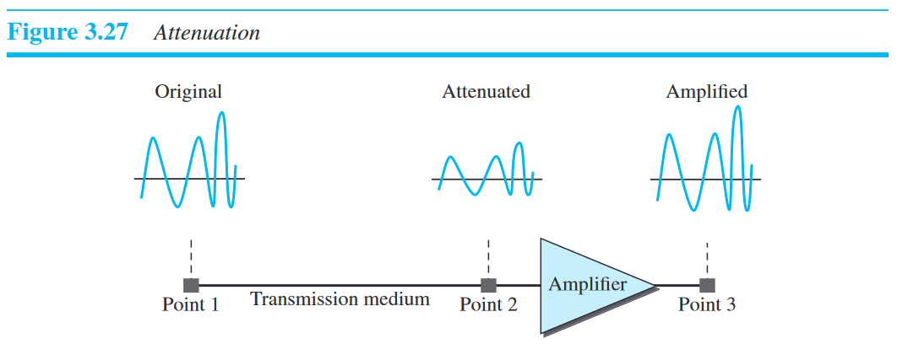
Attenuation

Slide 155
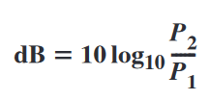

Attenuation
The decibel (dB) measures the relative strengths of two signals or one signal at two different points.
The decibel is negative if a signal is attenuated and positive if a signal is amplified.
Variables P1 and P2 are the powers of a signal at points 1 and 2, respectively

Slide 156
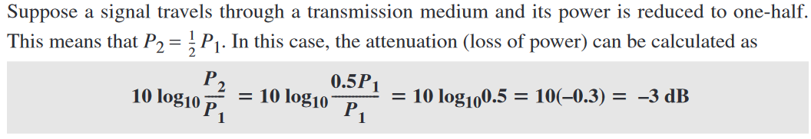
Example

Slide 157
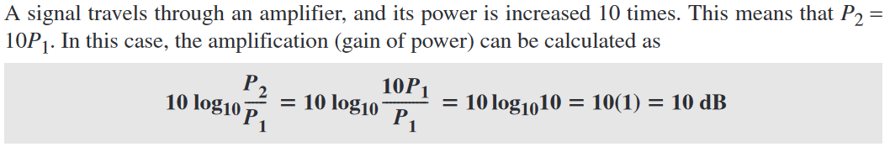
Example

Slide 158



Distortion
Distortion means that the signal changes its form or shape.
Distortion can occur in a composite signal made of different frequencies.
Each signal component has its own propagation speed through a medium and, therefore, its own delay in arriving at the destination.
Differences in delay may create a difference in phase if the delay is not exactly the same as the period duration.
In other words, signal components at the receiver have phases different from what they had at the sender.

Slide 159
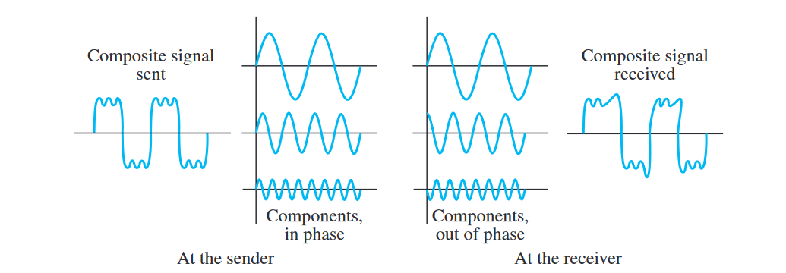
Distortion
Distortion means that the signal changes its form or shape.
Distortion can occur in a composite signal made of different frequencies.
Each signal component has its own propagation speed through a medium and, therefore, its own delay in arriving at the final destination.
Differences in delay may create a difference in phase if the delay is not exactly the same as the period duration.
In other words, signal components at the receiver have phases different from what they had at the sender.

Slide 160



Noise
Noise is another cause of impairment.
Thermal noise is the random motion of electrons in a wire, which creates an extra signal not originally sent by the transmitter.
Induced noise comes from sources such as motors and appliances.
Crosstalk is the effect of one wire on the other. One wire acts as a sending antenna and the other as the receiving antenna.
Impulse noise is a spike (a signal with high energy in a very short time) that comes from power lines, lightning.

Slide 161





Noise
SNR is actually the ratio of what is wanted (signal) to what is not wanted (noise).
A high SNR means the signal is less corrupted by noise; a low SNR means the signal is more corrupted by noise.
Because SNR is the ratio of two powers, it is often described in decibel units

Slide 162
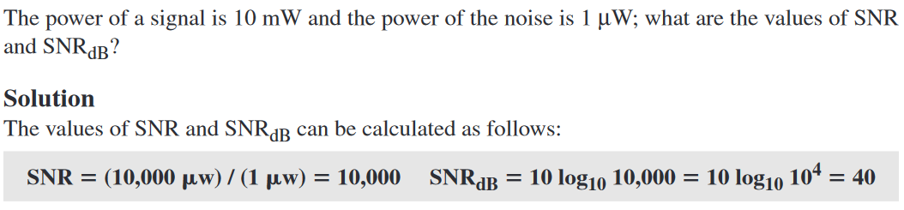
Noise

Slide 163
DATA RATE LIMITS
Data rate depends on three factors:
The bandwidth available
The level of the signals we use
The quality of the channel (the level of noise)

Slide 164
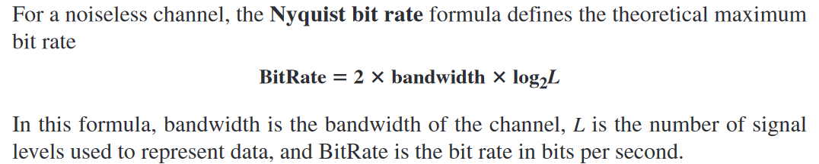
Nyquist Bit Rate

Slide 165
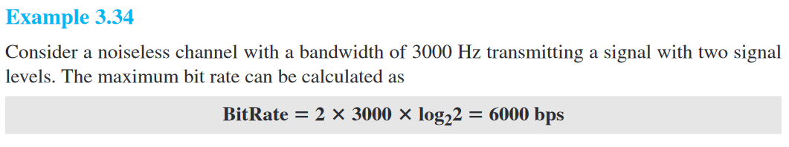
Example

Slide 166
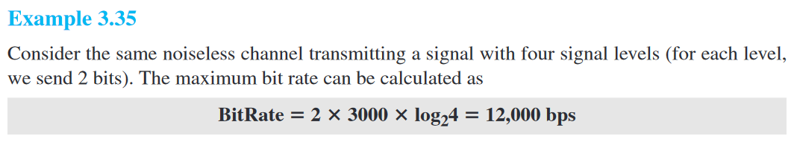

Slide 167
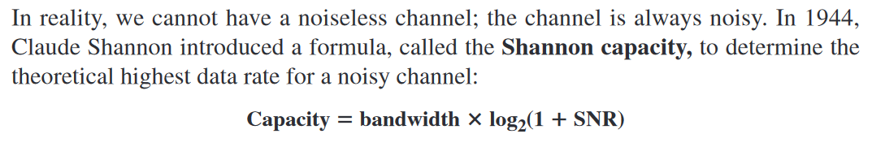
Shannon Capacity

Slide 168
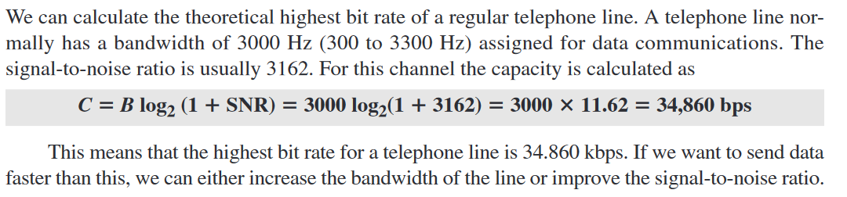
Example

Slide 169
Performance
Bandwidth
Bandwidth in hertz is the range of frequencies contained in a composite signal or the range of frequencies a channel can pass.
The term bandwidth can also refer to the number of bits per second that a channel, a link, or even a network can transmit.

Slide 170

Throughput
The throughput is a measure of how fast we can actually send data through a network.
Bandwidth in bits per second and throughput seem are different.
A link may have a bandwidth of B bps, but we can only send T bps through this link with T always less than B.
The bandwidth is a potential measurement of a link; the throughput is an actual measurement of how fast we can send data.

Slide 171


Slide 172



Latency
The latency or delay defines how long it takes for an entire message to completely arrive at the destination from the time the first bit is sent out from the source.
Latency is made of four components: propagation time, transmission time, queuing time and processing delay.

Slide 173



Propagation
Propagation time measures the time required for a bit to travel from the source to the destination

Slide 174


Slide 175




Transmission time
there is a time between the first bit leaving the sender and the last bit arriving at the receiver.
The first bit leaves earlier and arrives earlier; the last bit leaves later and arrives later.
The transmission time of a message depends on the size of the message and the bandwidth of the channel.

Slide 176


Slide 177





Queuing Time
The third component in latency is the queuing time, the time needed for each intermediate or end device to hold the message before it can be processed.
The queuing time is not a fixed factor; it changes with the load imposed on the network.
When there is heavy traffic on the network, the queuing time increases.

Slide 178


Jitter
Jitter is a problem if different packets of data encounter different delays and the application using the data at the receiver site is time-sensitive (audio and video data, for example).
If the delay for the first packet is 20 ms, for the second is 45 ms, and for the third is 40 ms, then the real-time application that uses the packets endures jitter.

Slide 179

Bandwidth delay

Slide 180

Bandwidth delay

